Slide 1
TensorFlow Quantum

Slide 2

TensorFlow Quantum (TFQ)
An open source quantum programming framework released in July, 2022
Designed for hybrid quantum-classical ML models
Built upon TensorFlow, Keras, and Cirq
Provides an easy way to embed quantum circuits into classical neural networks

Slide 3
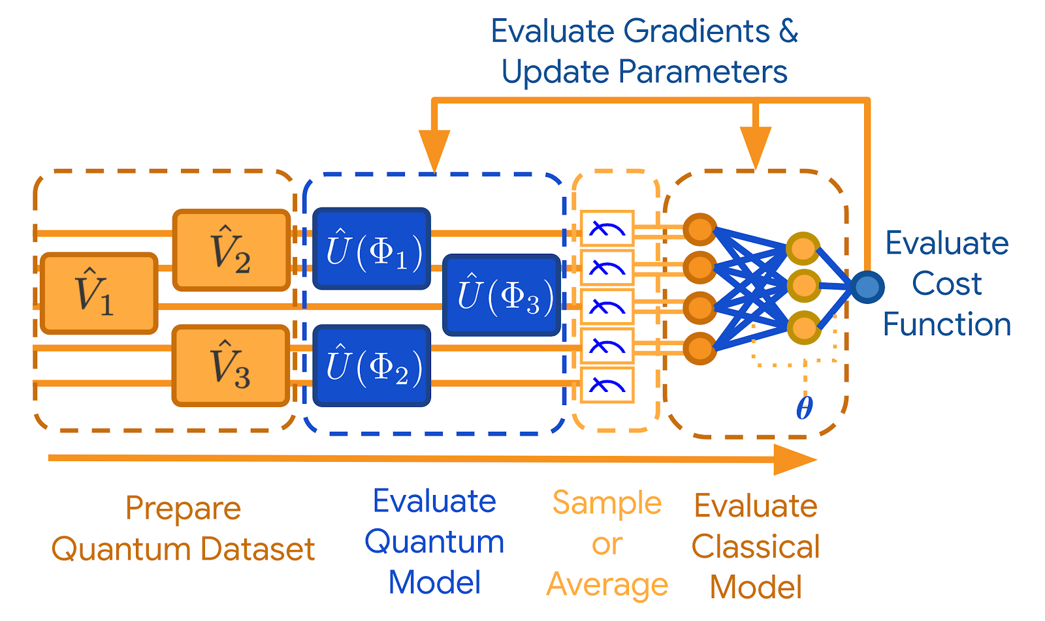
Design
First, we build the quantum circuit using Cirq and convert it into a Parametrized Quantum Circuit (PQC) Layer.
Once added to a deep learning model, TFQ treats it as a tf.Operation set in the computation graph, with its weights
and free variables will be updated based on classical backpropagation algorithm.
More specifically, the tf.Operation will sample from circuits, calculate expectation values, and output the resulting
state, allowing their gradients to be computed and used for optimization.
https://blog.tensorflow.org/2020/03/announcing-tensorflow-quantum-open.html

Slide 4
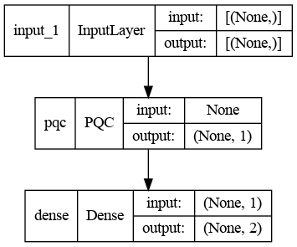
Parametric quantum circuit (PQC)
A quantum circuit consisting of quantum gates with freely adjustable parameters
is known as a Parametric Quantum Circuit (PQC), it can be transformed and
embedded into a classical deep learning model as a Keras layer
The free parameters are created as symbolic placeholders to hold uninitialized
variables, which is supported by the SymPy library.
The parameters created by SymPy.Symbol() are then trained as normal weights
in a classical neural network.
An hybrid quantum-classical neural network

Slide 5
Single Qubit Classification
In this small example, we will train a model that can predict the outcome of a single qubit circuit.
Each training data is a single qubit followed by a rx and a ry gate, a rx gate will rotate the default state |0>
counterclockwise around the x-axis by either 90 or 270 degree, resulting in two types of Bell states.
Additionally, a Gaussian noise with standard deviation of pi /4 is added to both rx and ry gates.
Thus, some of them are rotated by 90 ~ 135 degrees and have a greater probability of collapsing to the |1> state,
while the others, rotated by 270 ~ 315 degrees, would collapse to the |0> state.

Slide 6
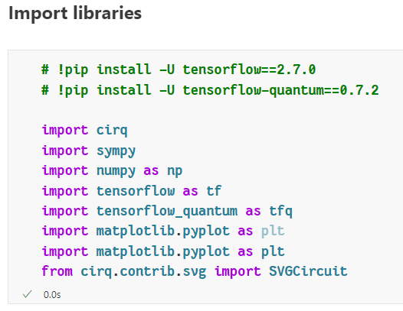
Single Qubit Classification: Import Libraries
Recently, the default version of Google Colab’s Python
kernel has been upgraded to 3.10, a version that is not
supported by the TensorFlow Quantum package.
We recommend installing it on your local machine with
the following environment configurations:
Unix-like system or WSL2
Python 3.8 with Conda virtual environment
TensorFlow version 2.7.0
TensorFlow Quantum version 0.7.2

Slide 7
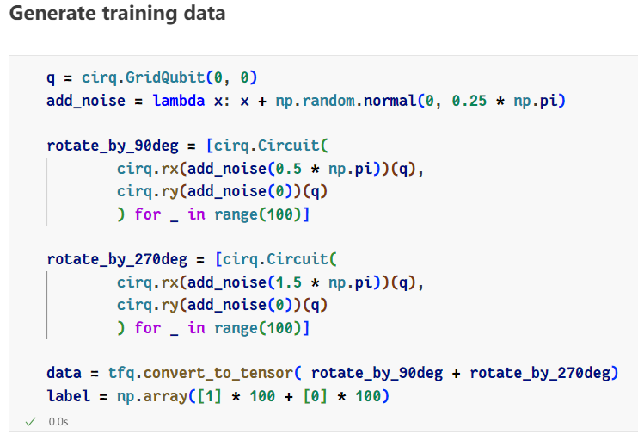
Single Qubit Classification: Create Training Data
We first create a lambda function to simplify the process
of adding noise. This function will add a random number
from 0 to pi / 4 to the input and return it.
The first half of the data are rotated by 90 ~ 145 degrees,
and the second half are rotated by 270 ~ 315 degrees.
These two categories of data are labeled by their bra-ket
notation, |1> and |0>, respectively.

Slide 8
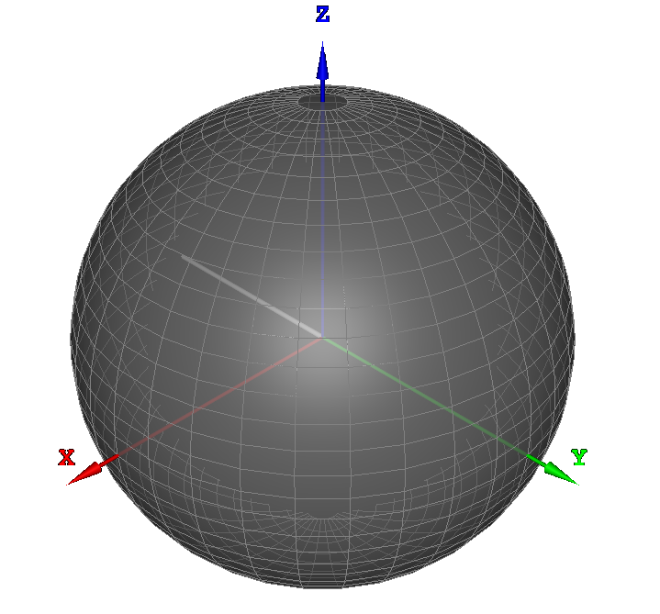
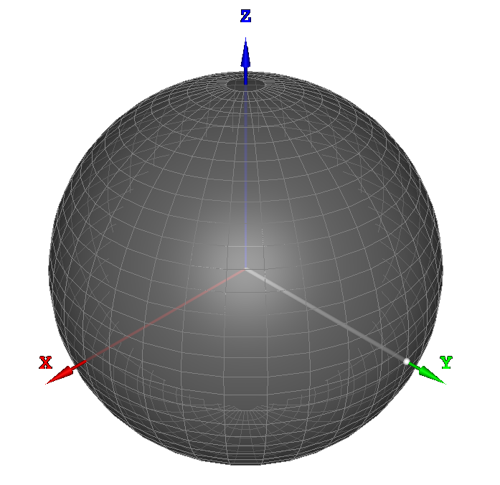
Single Qubit Classification: Create Training Data
The following Bloch spheres represent the two types of training data.
https://bits-and-electrons.github.io/bloch-sphere-simulator/

Slide 9
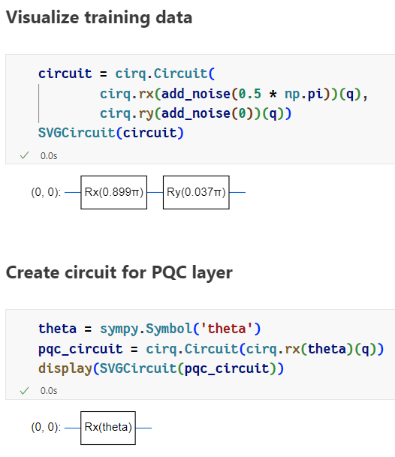
Single Qubit Classification: Build PQC Layer
The diagram on the left side represents a single sample point.
To create the PQC layer for our model, we need to use
sympy.Symbol(name) to create a placeholder for the rotation
angle of the rx gate.
Next, we create the PQC with a single rx gate to capture the
rotation information of the circuit.

Slide 10
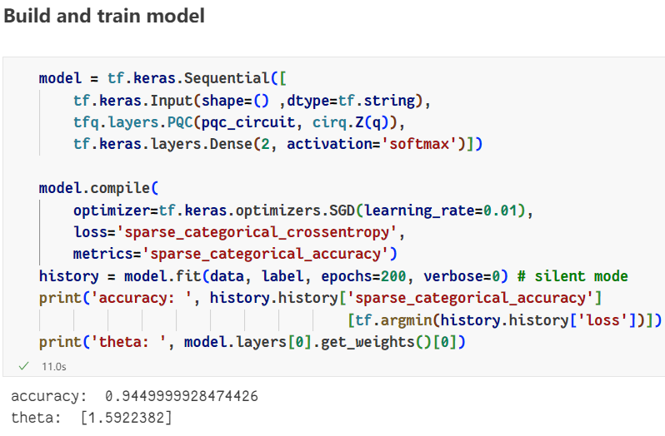
Single Qubit Classification: Build, Compile, and Train
The second argument is the measurement
operator, which determines the “perspective”
of measuring a qubit.
Note that a single qubit is a 2-dimensional
vector, so we need to prepare two neurons in
the last layer to represent its values.
Because we are not performing binary
classification, we adopt sparse categorical
cross-entropy for our loss function.

Slide 11
Single Qubit Classification: Result
The option “verbose” is set to 0 to hide the training
progress.
We achieve a decent accuracy of 94.4% for our
model, where the value of theta is approximately
1.59 ( or pi / 2) after the training, transforming the
qubit from |0> state to a Bell state.

Slide 12
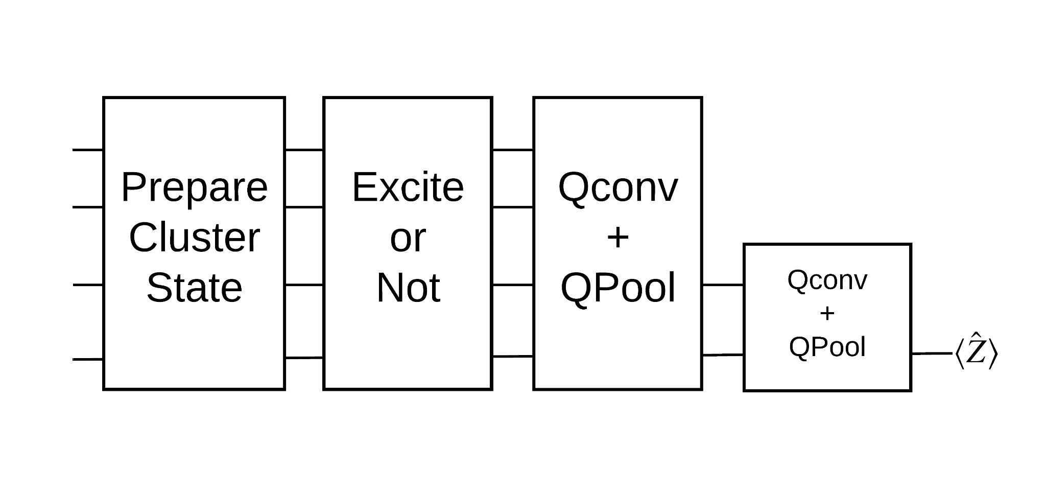
Quantum State Classifier
Now, we want to determine whether a quantum data is in an 'excited' state, particularly as a cluster state.
A cluster state can be seen as highly entangled quantum data, where an rx gate applied to any of its qubits
indicates the excitation.
To address the problem mentioned above, we will build a Quantum Convolutional Neural Network (QCNN) model
with quantum convolutional and pooling layers.
QCNN Architecture
https://www.tensorflow.org/quantum/tutorials/qcnn

Slide 13
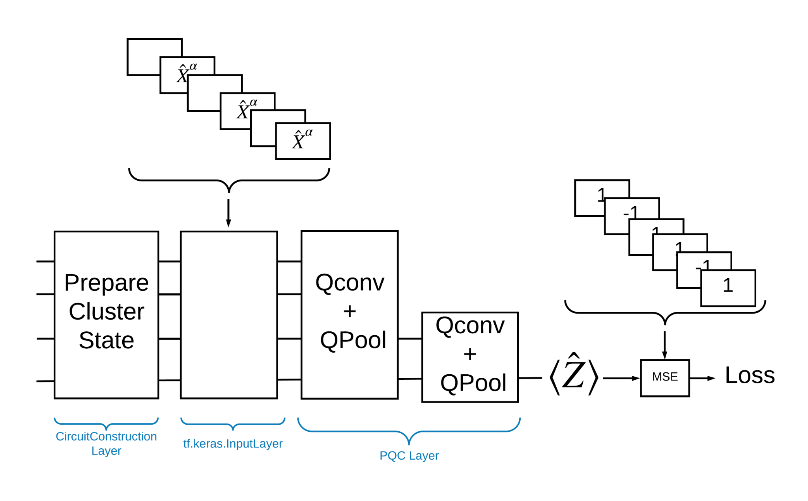
Quantum Convolutional Neural Network (QCNN)
Implemented by TFQ, a QCNN model can be broken
down into the following building blocks:
A circuit transforming initial qubits into a cluster state
An input layer that accepts circuits as input data
Interleaving quantum convolutional and pooling layers
Readout of the PQC layer and a loss function
An ptimization algorithm for training
QCNN TFQ implementation
https://www.tensorflow.org/quantum/tutorials/qcnn

Slide 14
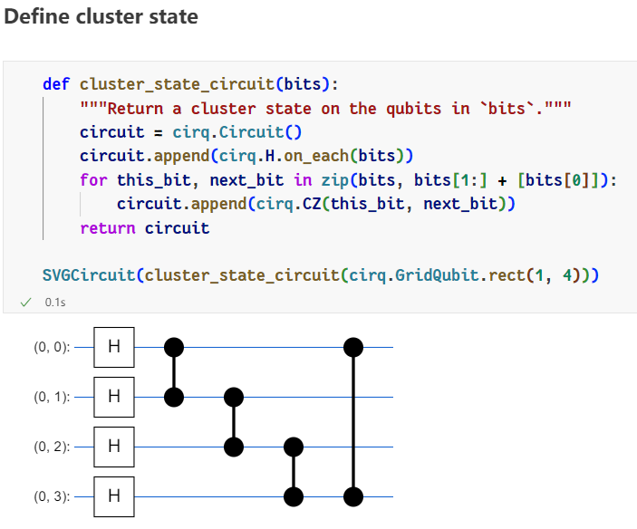
QCNN: Prepare Cluster State
The cluster state circuit is defined by first applying
Hadamard gates to all qubits, followed by pairs of cz gates.
Only four qubits are used here for demonstration.

Slide 15
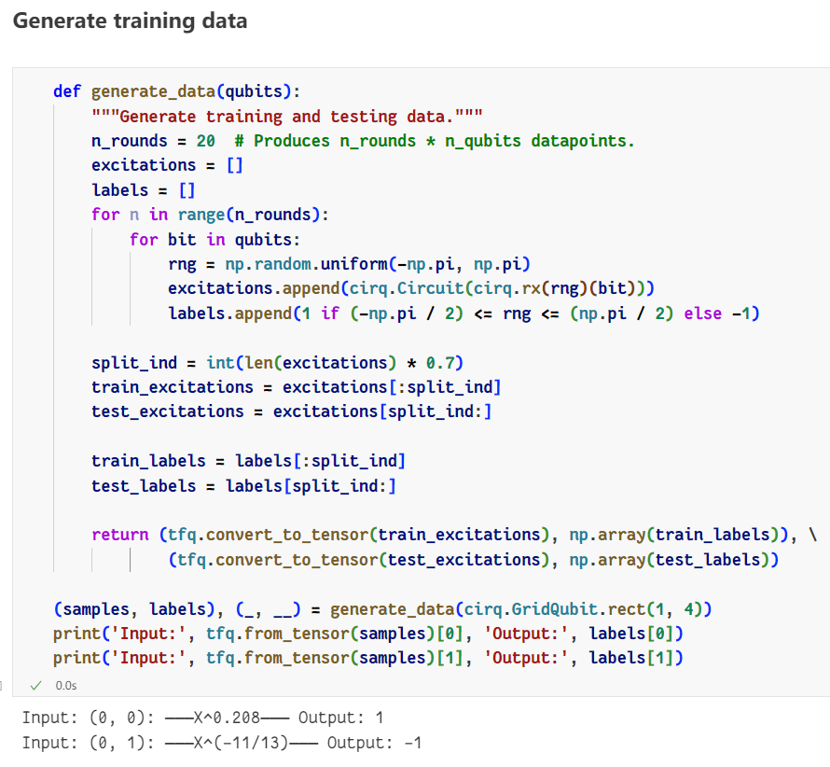
QCNN: Generate training data
Each circuit consists of a single qubit and a rx gate.
If the state vector is in the northern hemisphere, we
label it as “1”, otherwise, it is “0”.
70% of the training data is used for training, while
the remaining 30% is for testing.
The circuits will be converted into tensors, ready for
embedding into the model.

Slide 16
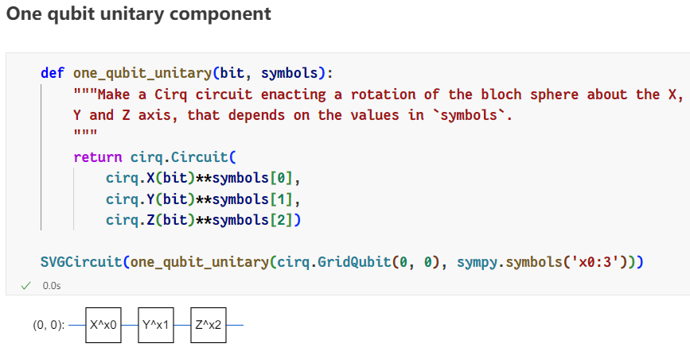
QCNN: One-Qubit Unitary
Following the approach in Tucci paper, we implement the following unitaries for the quantum layers.
The free variables here are created by sympy.symbols() and used for the exponents of the Pauli-X, Y, and Z gates.

Slide 17
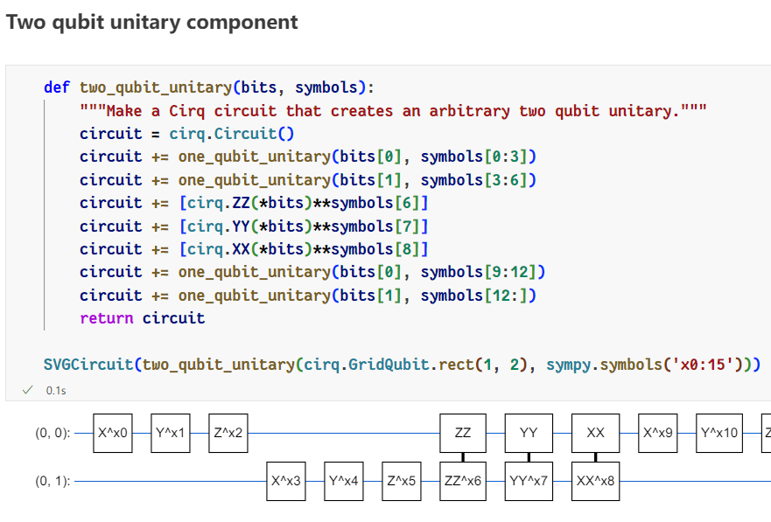
QCNN: Two-Qubit Unitary

Slide 18
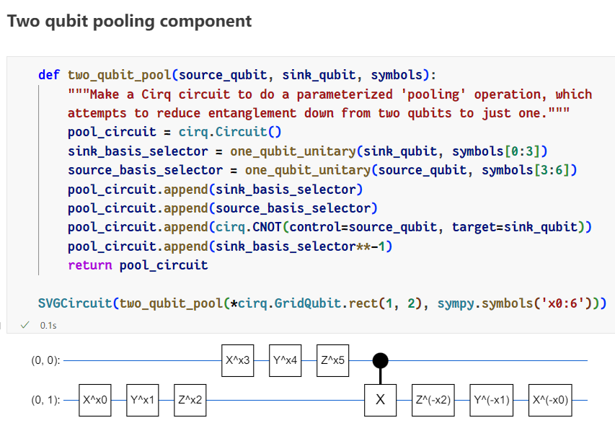
QCNN: One-Qubit Pooling Unit

Slide 19
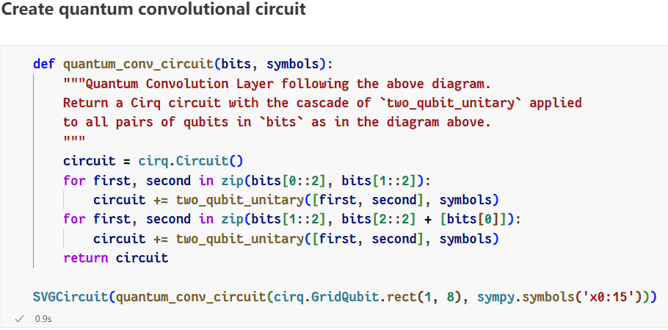
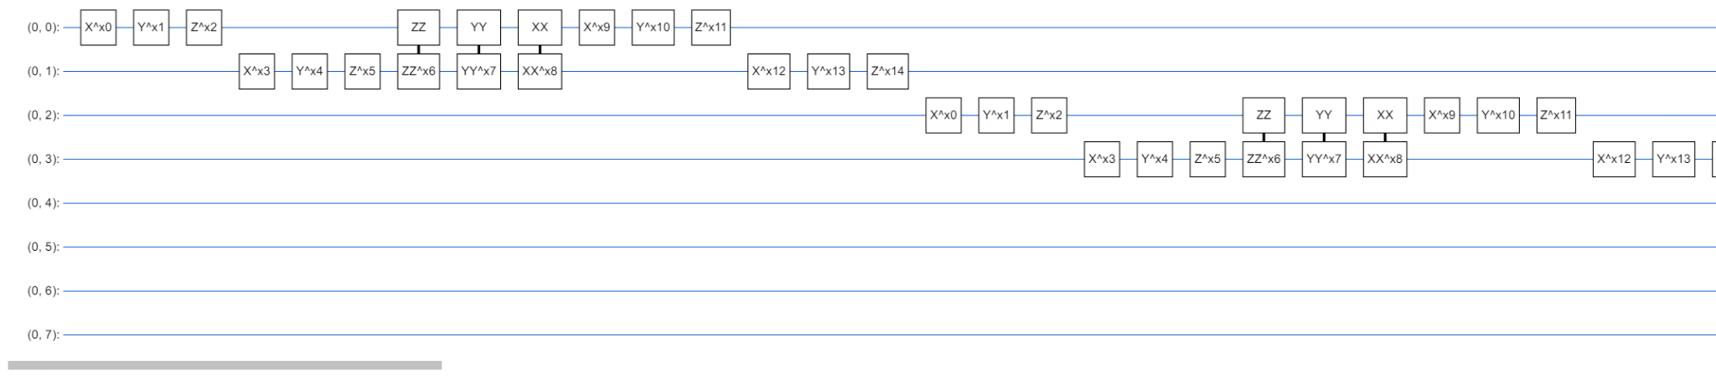
QCNN: Convolutional Circuit
Using the components we created, we can
build a eight-qubit convolutional and pooling
circuit for the PQC layer.
As you can see, Python’s slicing technique
helps us apply two-qubit quantum gate to
every pair of adjacent qubits.

Slide 20
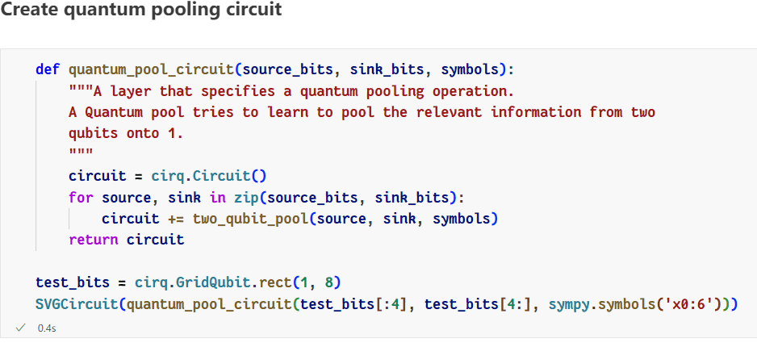
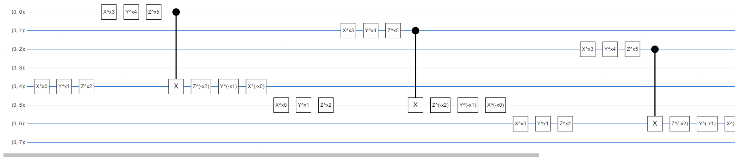
QCNN: Pooling Circuit
The pooling circuit will pool from N qubits to
N/2 qubits using series of two-qubit pooling
components

Slide 21
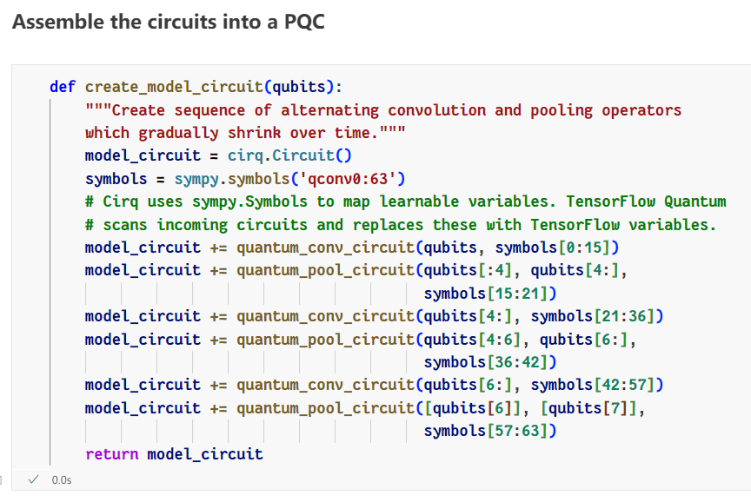
QCNN: PQC Circuit
We interleave three convolutional and three pooling circuits to create the PQC.
Each symbol must be independent to make the weights update more effective.

Slide 22
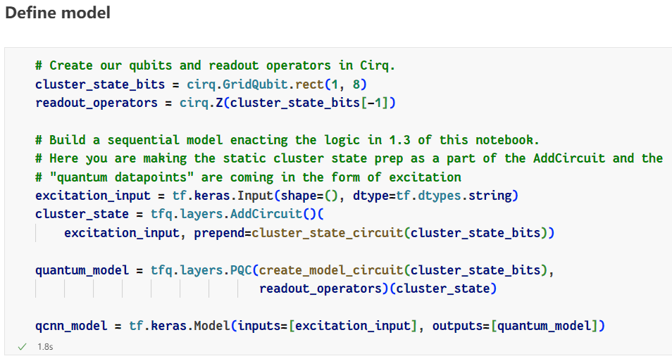
QCNN: Model Definition
The readout is set as the Pauli-Z gate on the last qubit to measure the state vector's projection along the Z-axis.
The cluster state circuit is added before the input layer using tfq.layers.AddCircuit()’s prepend option.

Slide 23
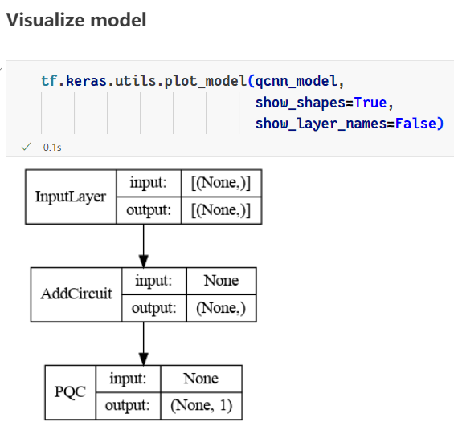
QCNN: Model Visualization
Since the AddCircuit() prepends the cluster state circuit, the input layer should be created and placed first.
The model is successfully built according to the diagram we showed in the previous slide.
QCNN TFQ implementation

Slide 24
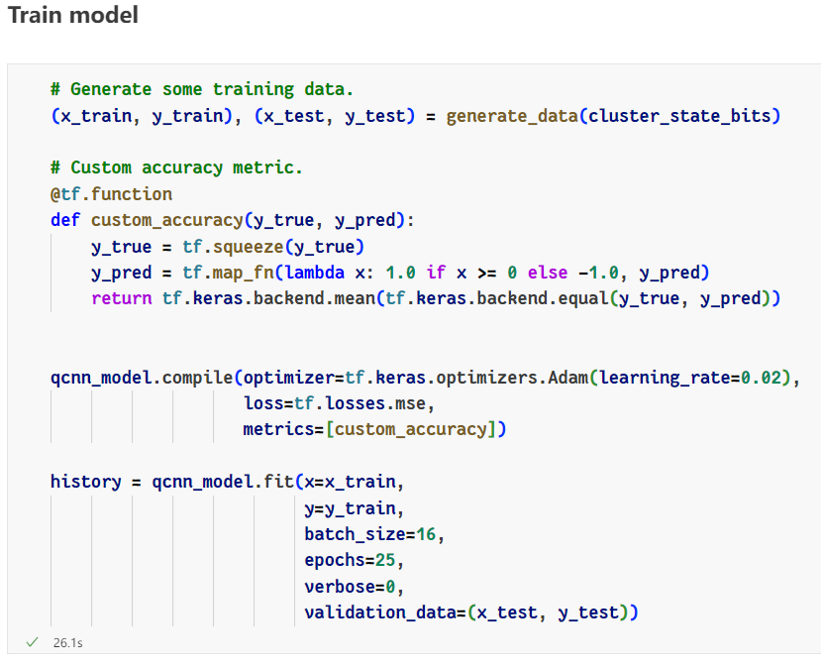
QCNN: Model Training
The output of the model is not an integer
label but a state vector, so we define a
custom metric to calculate the model’s
accuracy on the fly.
The batch size is set to 16 to perform a
full batch training.

Slide 25
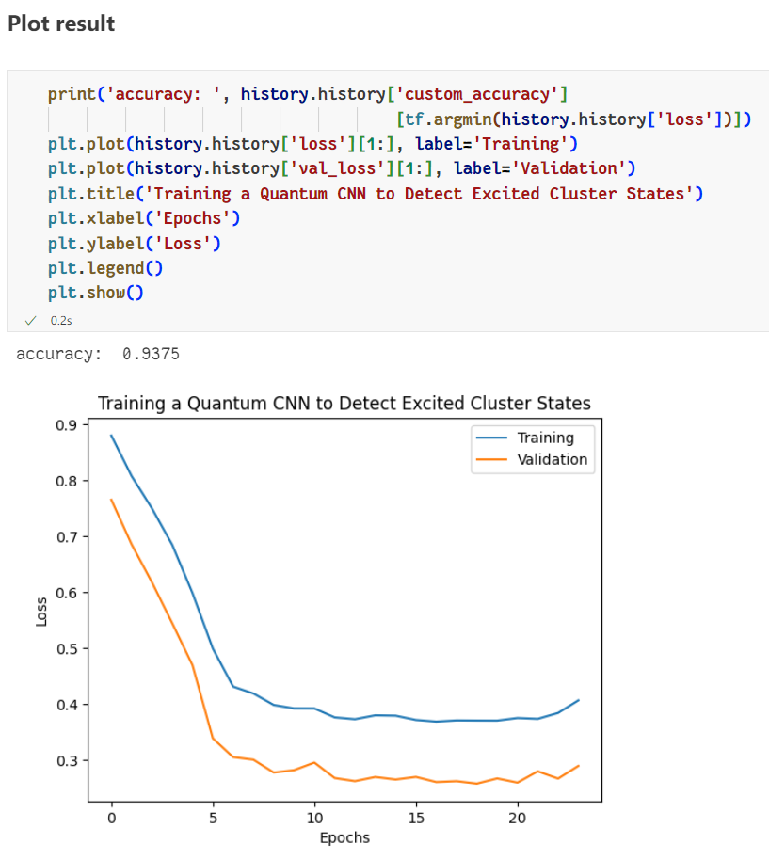
QCNN: Result
The model converges faster rapidly at the beginning of the training, showcasing the advantage of using QCNN over CNN.

Slide 26
Sources
“Hybrid Quantum-classical Machine Learning”: https://tf.wiki/en/appendix/quantum.html
“Quantum CNN” by TensorFlow Quantum: https://www.tensorflow.org/quantum/tutorials/qcnn
TensorFlow Quantum API Document: https://www.tensorflow.org/quantum/api_docs/python/tfq
TensorFlow Quantum Official Guide: https://www.tensorflow.org/quantum/overview

